Slide 1
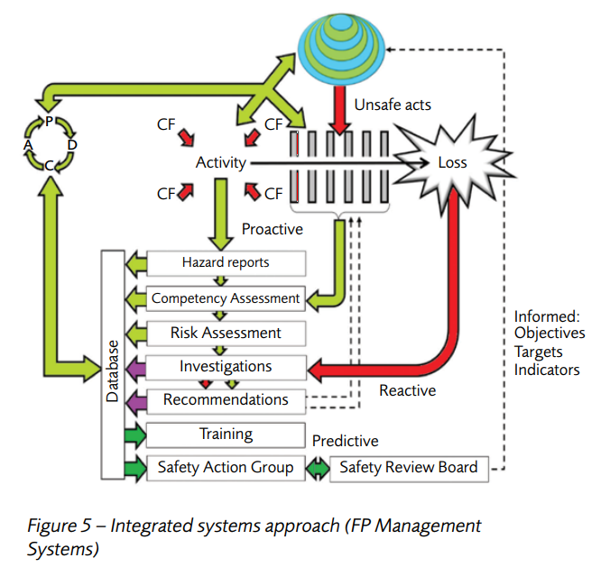
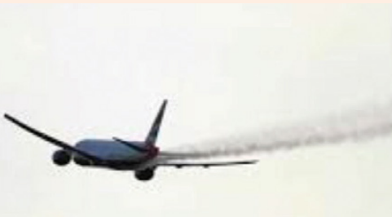
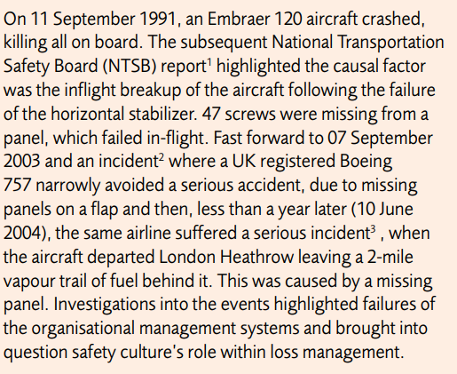
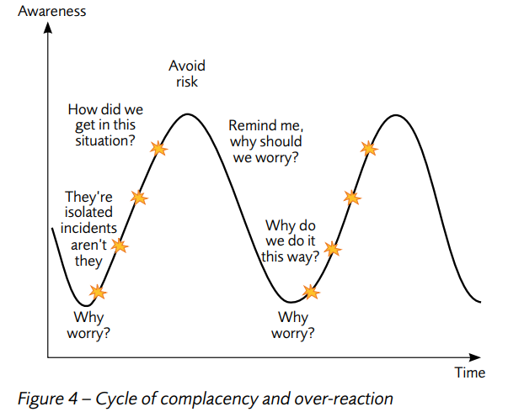
Some lessons from the aviation industry
Will you fly again?
FINDINGS
The aircraft were dispatched in an unairworthy condition • work completed was not identified or raised on task cards • removed items were not identified and stored in approved areas • a general lack of compliance with the procedures during the maintenance and inspection • staff participated in practices and procedures that were not approved • management personnel failed to ensure the adherence to approved procedures the quality assurance programs in place were not effective • management did not establish an effective safety culture for staff.
www.mhiriskengineers.com
Major Hazard Safety Engineers
Conclusion
Poor safety culture in the organization • No maintenance records kept• procedural non-compliance by staff• supervisors and management accepted bad behaviors • conflict between commercial pressures and accomplishment of the work

